Slide 1




Danny’s Diner – SQL Case Study (8 Week SQL Challenge)
Turning raw data into business insights using SQL
https://github.com/rohit-baikar
Rohit Baikar
Data Analyst

Slide 2

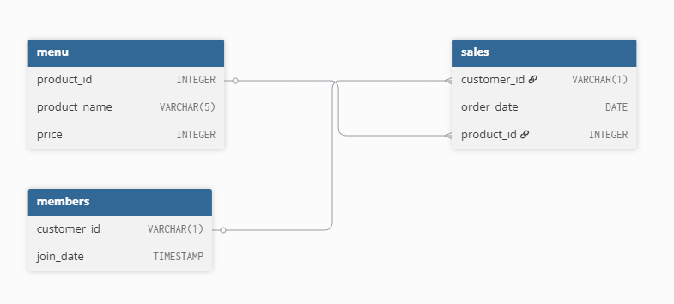
Data Model(Entity Relationship Diagram)
https://github.com/rohit-baikar
Rohit Baikar
Data Analyst

Slide 3

Sample Data
customer_id | order_date | product_id
A | 2021-01-01 | 1
A | 2021-01-01 | 2
A | 2021-01-07 | 2
A | 2021-01-10 | 3
A | 2021-01-11 | 3
A | 2021-01-11 | 3
B | 2021-01-01 | 2
B | 2021-01-02 | 2
B | 2021-01-04 | 1
B | 2021-01-11 | 1
B | 2021-01-16 | 3
B | 2021-02-01 | 3
C | 2021-01-01 | 3
C | 2021-01-01 | 3
C | 2021-01-07 | 3
product_id | product_name | price
1 | sushi | 10
2 | curry | 15
3 | ramen | 12
customer_id | join_date
A | 2021-01-07
B | 2021-01-09
https://github.com/rohit-baikar
Rohit Baikar
Data Analyst

Slide 4

Solved Questions
Customer Spending & Visits
  What is the total amount each customer spent at the restaurant?
  How many days has each customer visited the restaurant?
Customer Preferences & Popular Items
  What was the first item from the menu purchased by each customer?
  What is the most purchased item on the menu and how many times was it purchased by all customers?
  Which item was the most popular for each customer?
Membership Behaviour Analysis
  Which item was purchased first by the customer after they became a member?
  Which item was purchased just before the customer became a member?
  What is the total items and amount spent for each member before they became a member?
Loyalty Points & Rewards
  If each $1 spent equates to 10 points and sushi has a 2x points multiplier - how many points would each customer have?
  In the first week after a customer joins the program (including their join date) they earn 2x points on all items, not just sushi - how many points do customer A and B have at the end of January?
https://github.com/rohit-baikar
Rohit Baikar
Data Analyst

Slide 5

Answers
Business Problem
https://github.com/rohit-baikar/8-week-sql-challenge/blob/main/Case-Study-1
Answers
https://github.com/rohit-baikar/8-week-sql-challenge/blob/main/Case-Study-1-Solutions.txt
https://github.com/rohit-baikar
Rohit Baikar
Data Analyst

